Slide 1
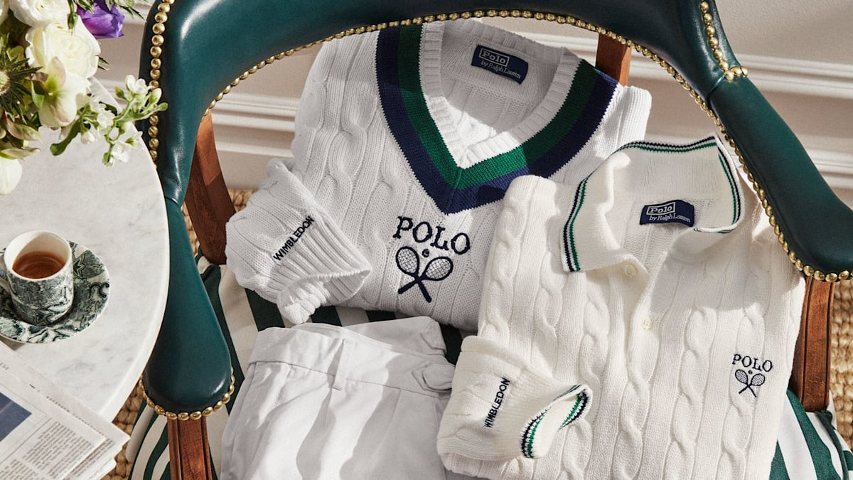
RALPH LAUREN
STYLE SERVES LOVE: A GOLDEN OPPORTUNITY
1 | Joey

Slide 2
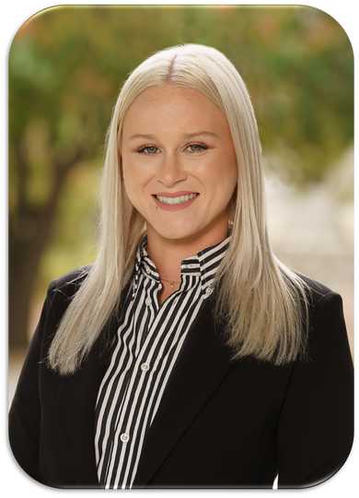
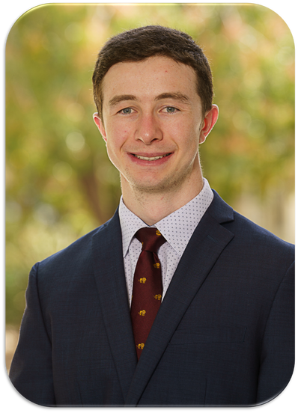
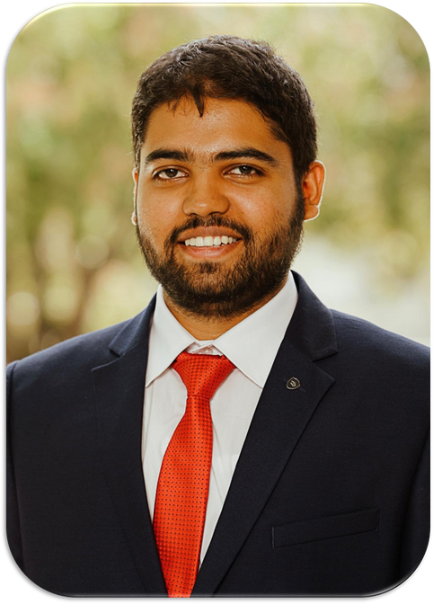
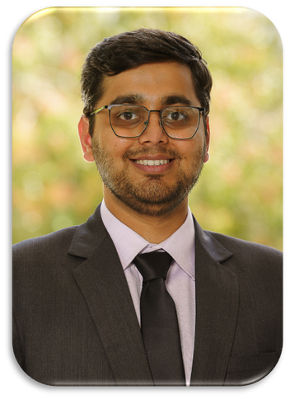
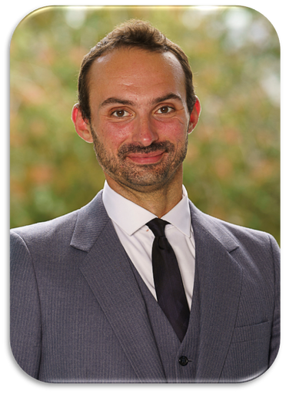
Tatum Craft
Chief People Officer
Mark Swiler
Chief Financial Officer
Akhilesh Khadse
Chief Strategy Officer
Gunjan Patil
Chief Innovation Officer
Joey Burquest
Chief Executive Officer

Slide 3
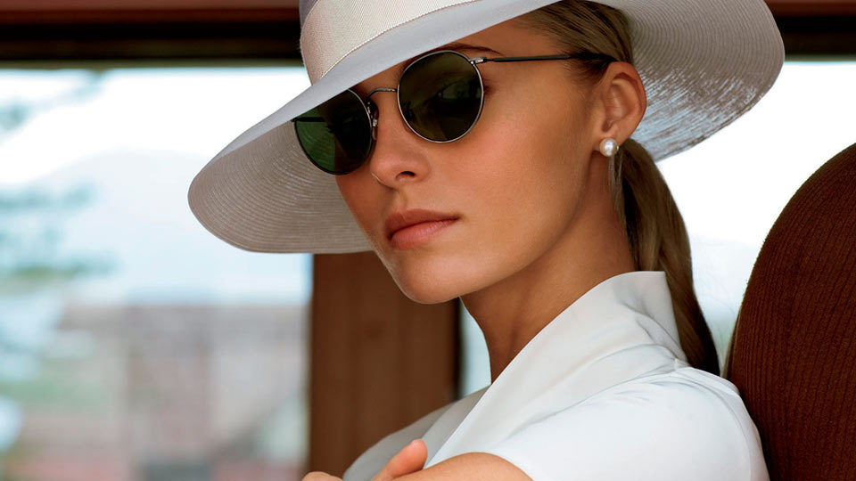
$25M
SPORTS LINE & PROMOTION
3 | Joey

Slide 4
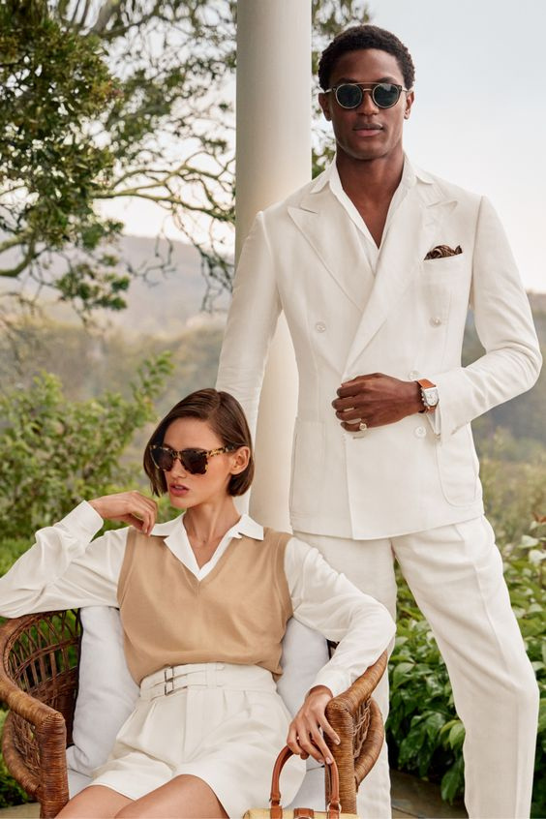
AGENDA
Company Overview
Sporting Trends
Opportunity
Breakdown
Conclusion
4 | Joey

Slide 5
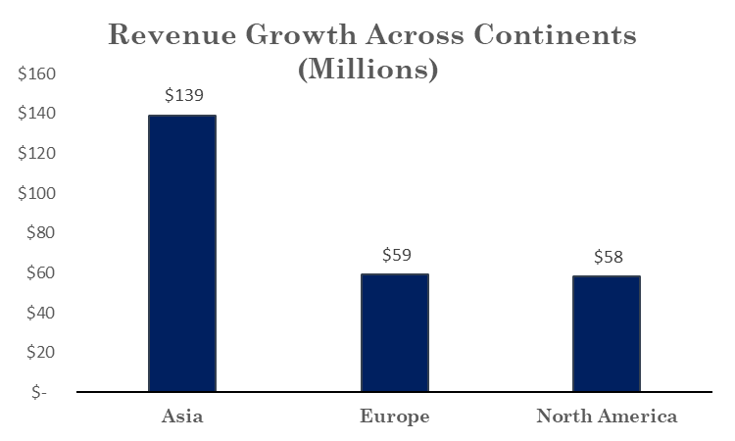
FINANCIAL OVERVIEW
5 | Gunjan

Slide 6
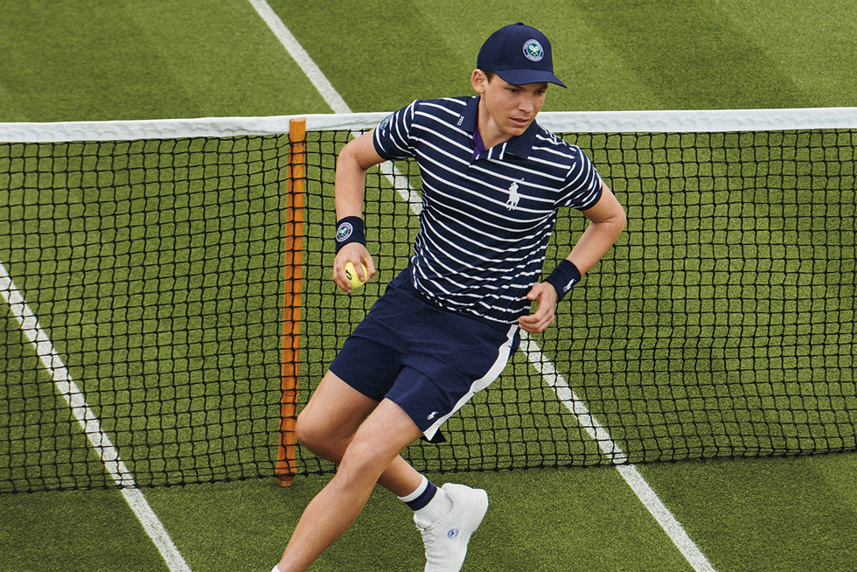
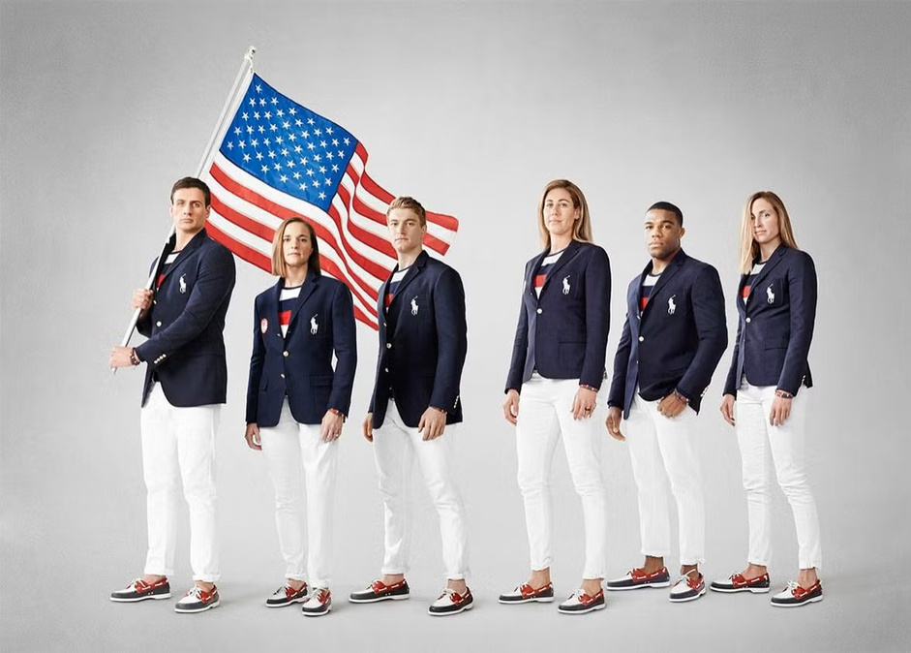
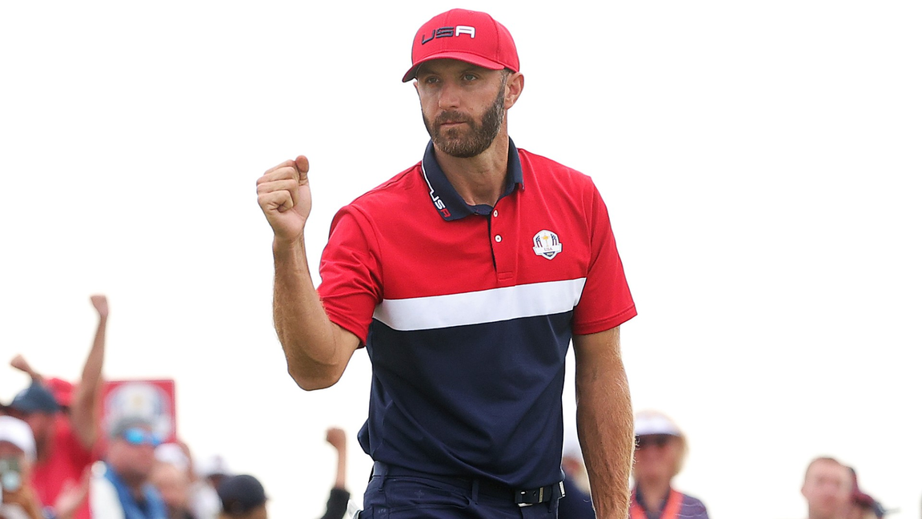
SPORTS PARTNERSHIPS
US Open
&
Wimbledon
Olympic Games
Ryder Cup Golf
6 | Gunjan

Slide 7
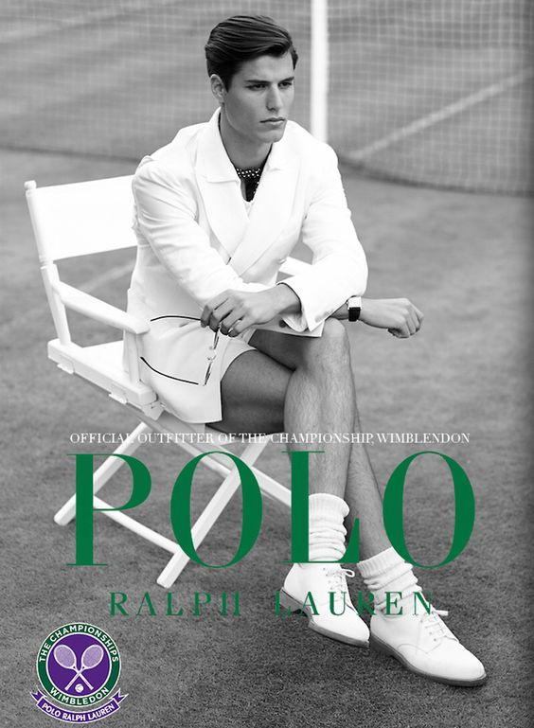
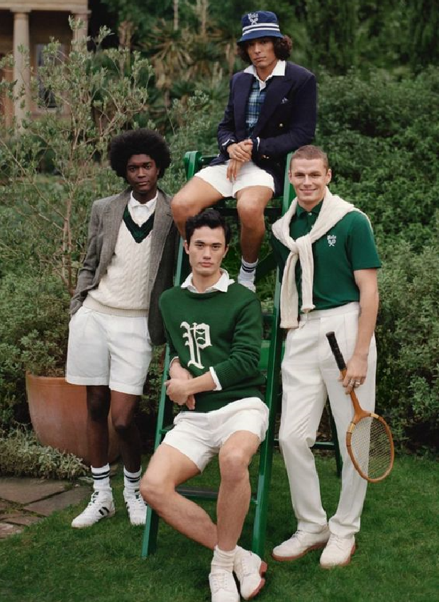
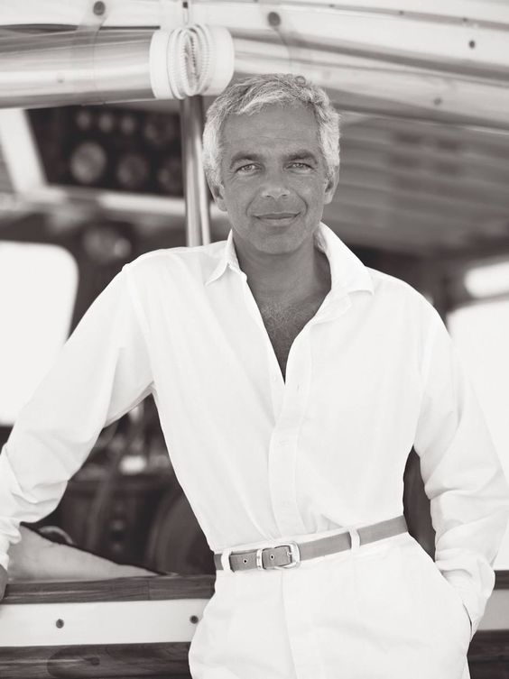
POLO: THE BRAND

Slide 8
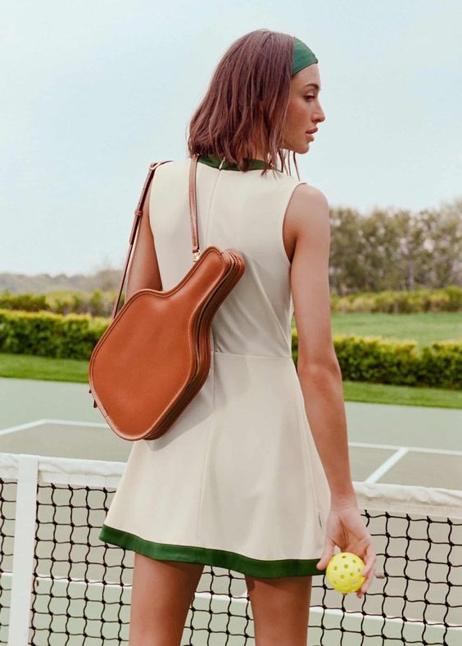
WHAT IS
PICKLEBALL?
8 | Akhilesh

Slide 9
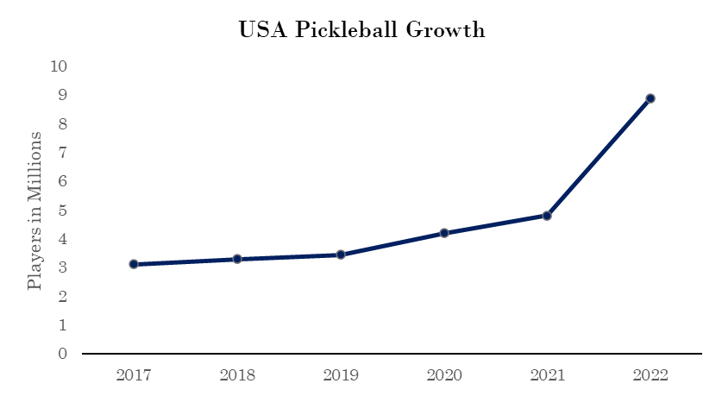
9 | Akhilesh
Notes:
Add period after S or change to USA "USA Pickleball Growth"

Slide 10
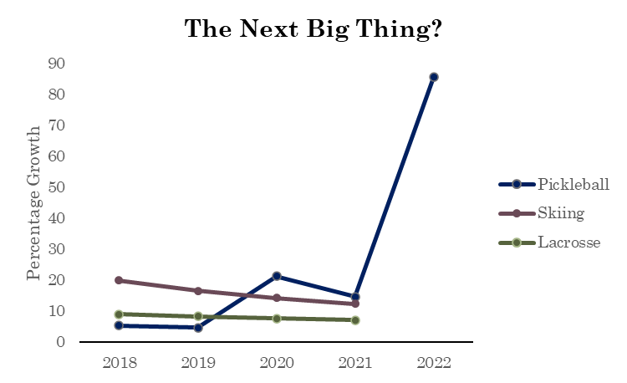
10 | Akhilesh

Slide 11
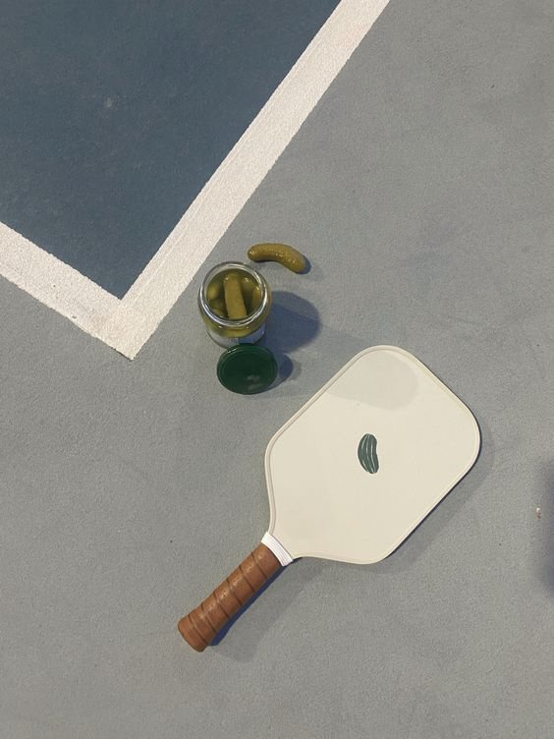
A TREND SETTER?
120% projected growth in overall pickleball players for 2023
18% growth in female players as to 13% in male players
53% of core players are senior citizens
11 | Akhilesh

Slide 12
THE GOLDEN OPPORTUNITY:
12 | Tatum

Slide 13

13 | Tatum

Slide 14
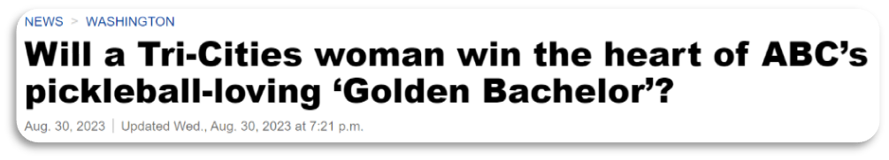
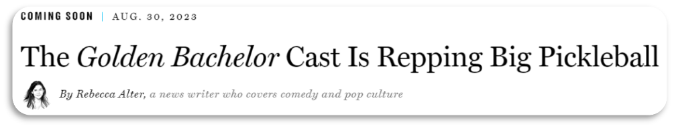
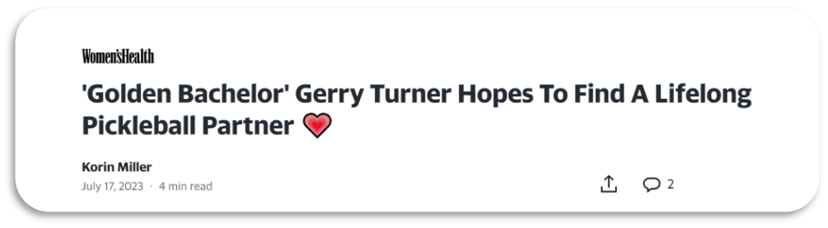
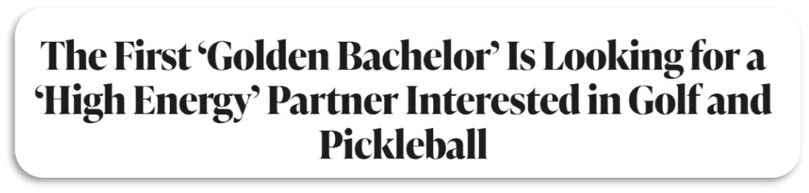
14 | Tatum

Slide 15
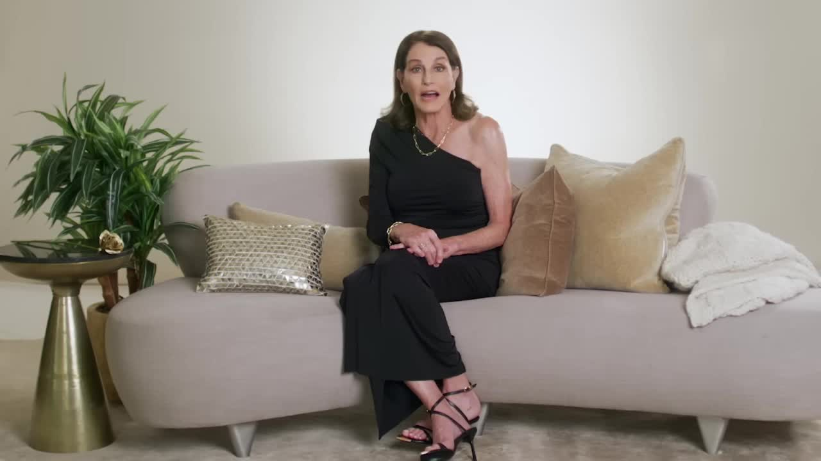
15 | Tatum

Slide 16
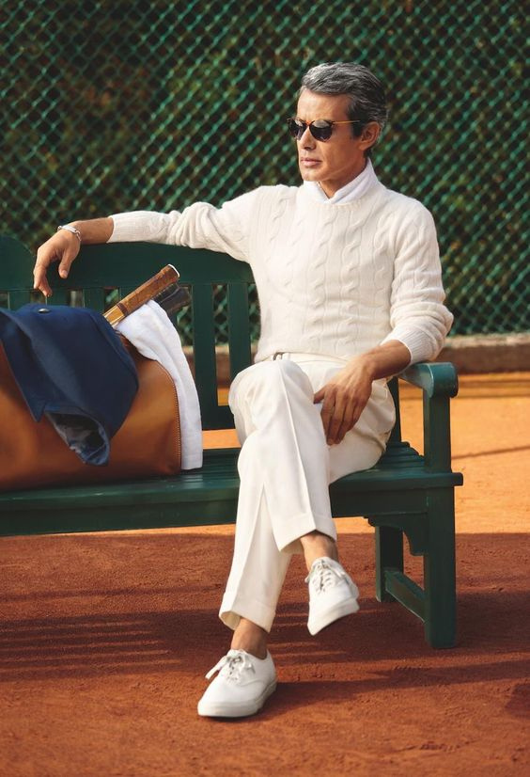
RALPH LAUREN TO HOST PICKLEBALL GROUP DATE
Seniors untapped population- 6%
Adults 65+ spend 3X more time watching TV
More likely to watch Golden Bachelor
16 | Tatum

Slide 17
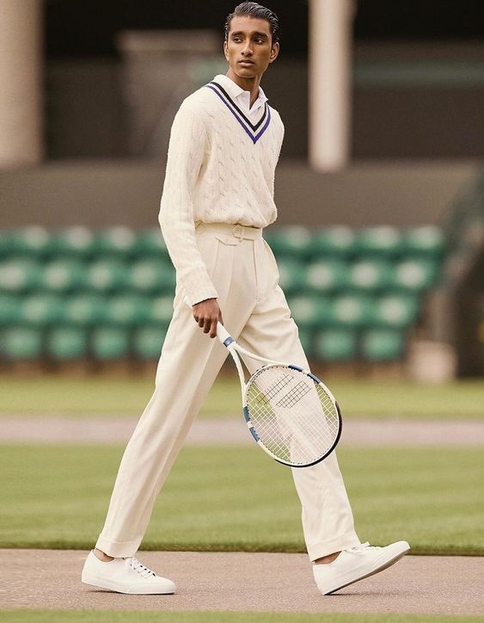
BRAND OVERLAPS
Ralph Lauren + Bachelor:
Formal
Classic
Elegant
Sophisticated
Modest
Upper class
17 | Tatum

Slide 18
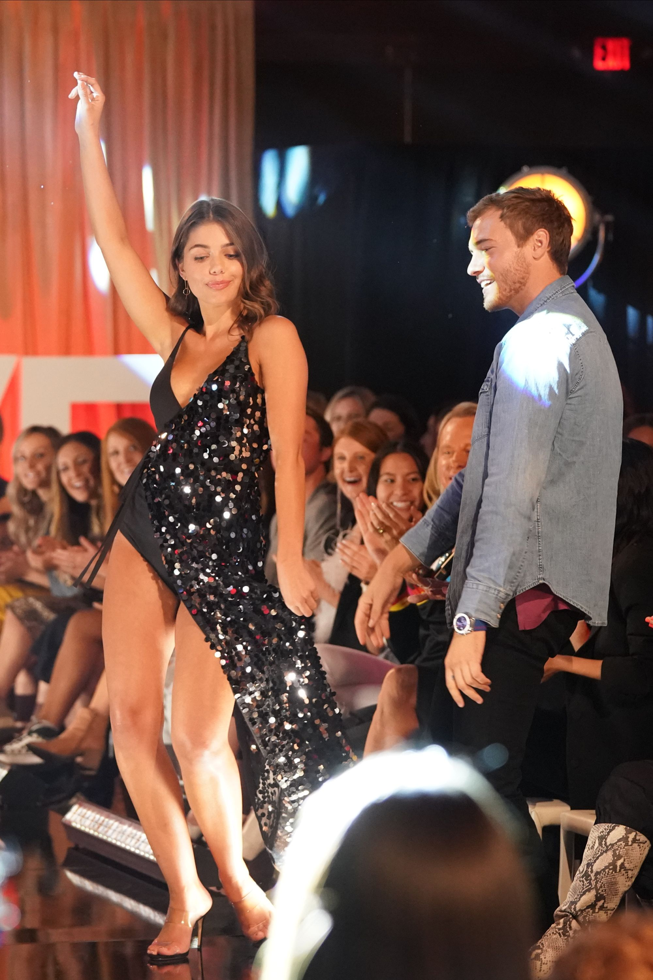
SUCCESS STORY:
REVOLVE
The Bachelor - Season 24
18 | Tatum

Slide 19
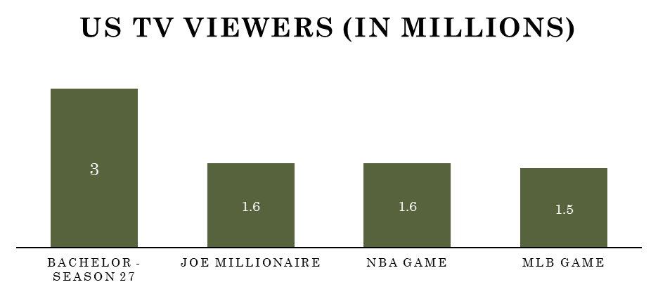
19 | Mark

Slide 20
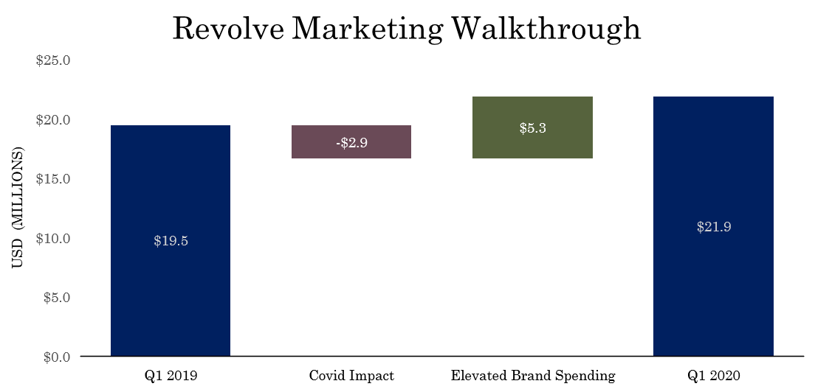
20 | Mark

Slide 21
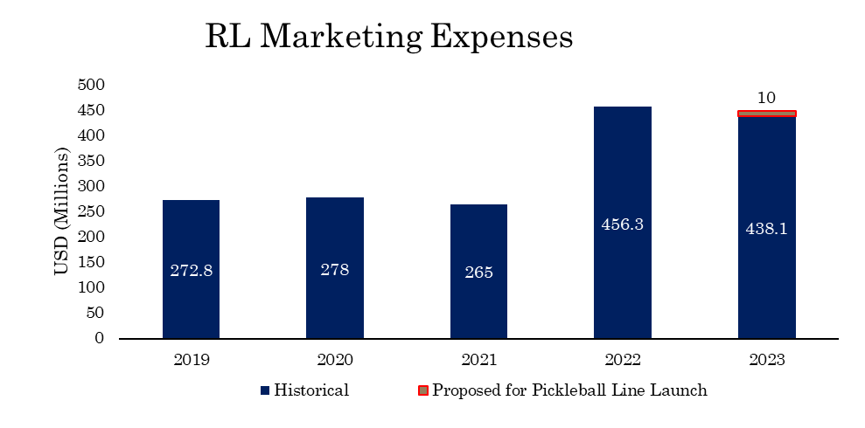
21 | Mark
Notes:
Elevated levels coming out of COVID to promote digital channels, and new customer acquisition

Slide 22
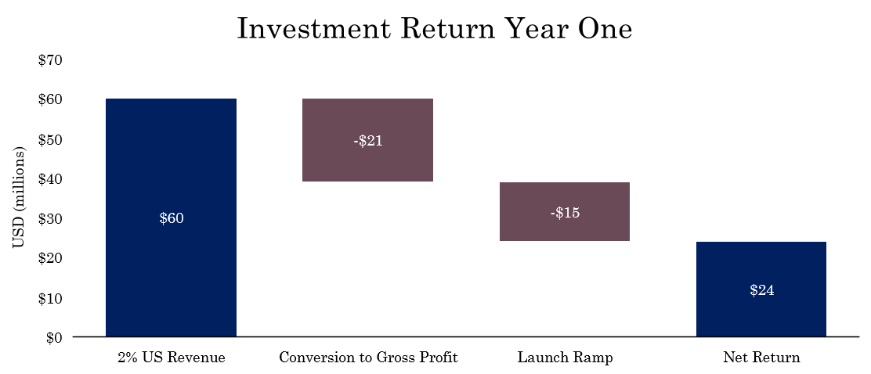
22 | Mark

Slide 23
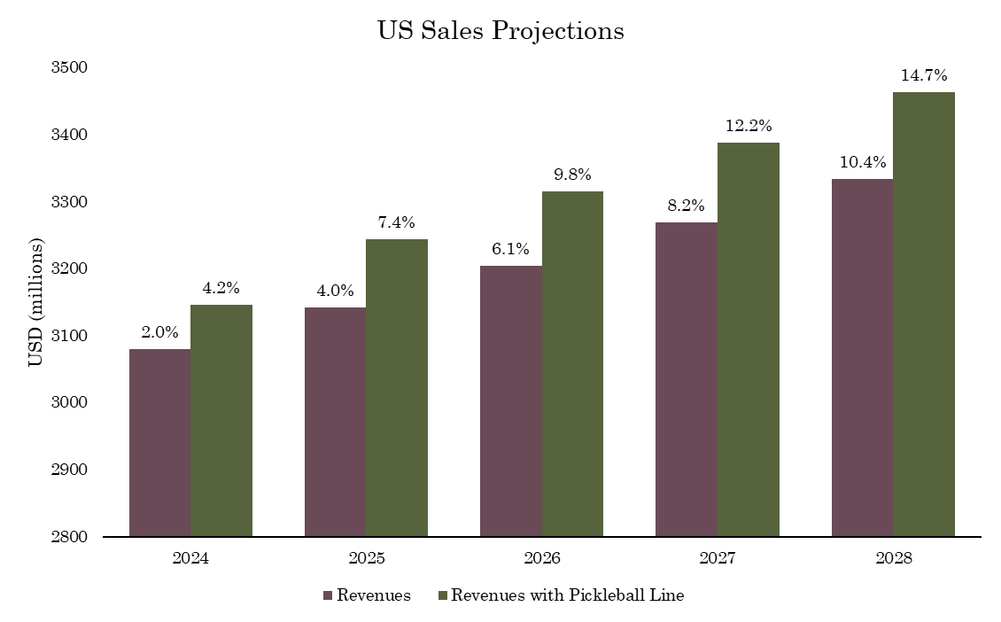
23 | Mark

Slide 24
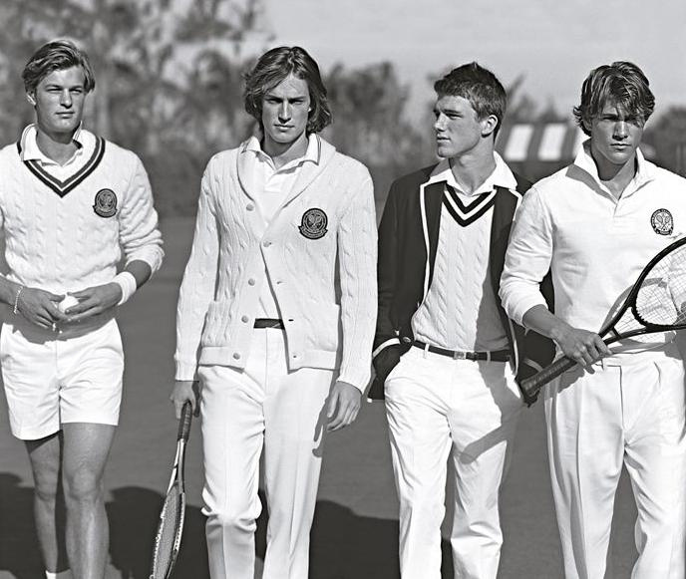
TIMELINE
Create Pickleball Line
Q4 FY23-24
Episode Airs
Q3 FY24-25
Episode Recording
Q1 FY24-25
24 | Joey

Slide 25
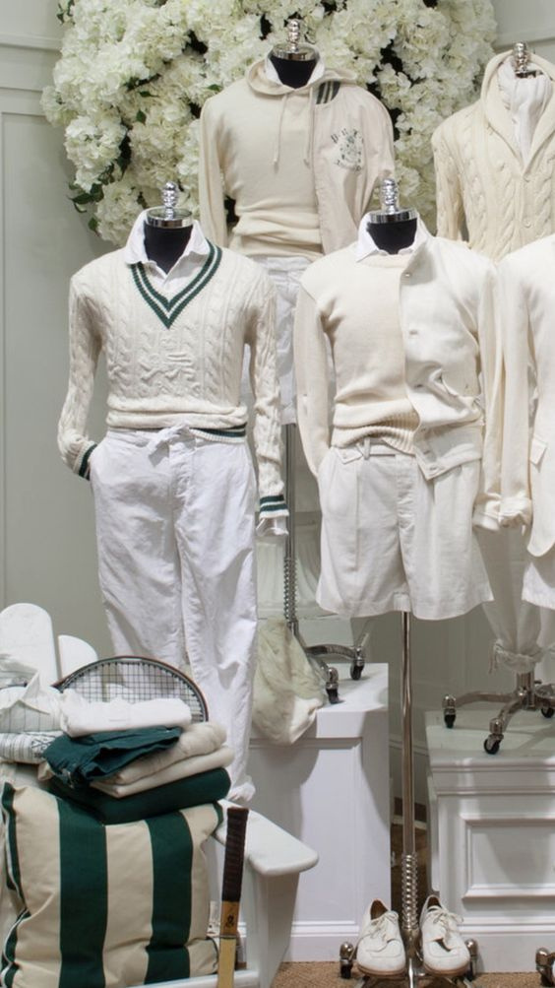
INVESTMENT
Financial investment in new line + ABC
RETURN
Skyrocketing pickleball popularity
Readdress original customer demographic
The Bachelor viewership guarantees audience
New clothing line
Leverage assets in Polo RL Tennis label
25 | Joey

Slide 26
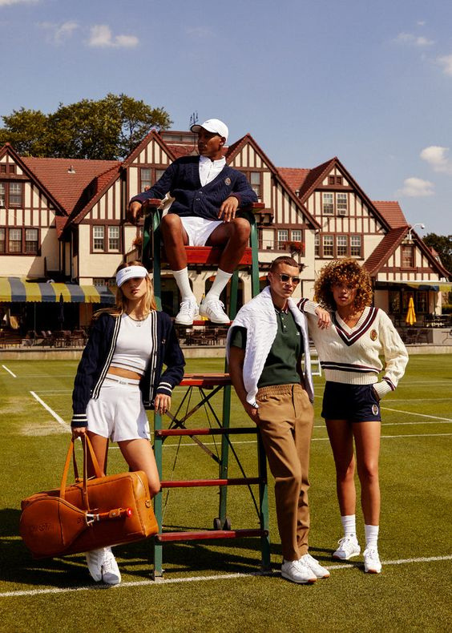
THANK YOU

Slide 27
SOURCES
2020 Annual Report . (2021, February 25). https://s2.q4cdn.com/892021348/files/doc_financials/2020/ar/REVOLVE-2020-Annual-Report.pdf
Cobb, K. (2023, July 17). The first “Golden bachelor” is looking for a “high energy” partner interested in golf and pickleball. TheWrap. https://www.thewrap.com/the-golden-bachelor-gerry-turner-abc/
Davis, L., Polk, A., Patel, S., Runyon, C., & Stringer, A. (n.d.). Ralph Lauren Designer Brand Analysis. https://ralphlaurenbrandanalysis.weebly.com/target-consumer.html
Depp, C. A., Schkade, D. A., Thompson, W. K., & Jeste, D. V. (2010, August). Age, affective experience, and television use. American journal of preventive medicine. https://www.ncbi.nlm.nih.gov/pmc/articles/PMC3593658/
Herald, T.-C. (2023, August 30). Will a tri-cities woman win the heart of ABC’s pickleball-loving “golden bachelor”? Spokesman.com. https://www.spokesman.com/stories/2023/aug/30/will-a-tri-cities-woman-win-the-heart-of-abcs-pick/
Lorenz, T. (2022, August 18). The hastag #OldMoney goes viral on TikTok. Town & Country Magazine. https://www.townandcountrymag.com/society/money-and-power/a40835461/old-money-obsession-tiktok/
MIller, K. (2023, July 17). “Golden bachelor” Gerry Turner hopes to find a lifelong pickleball partner 💗. Yahoo! https://www.yahoo.com/lifestyle/golden-bachelor-gerry-turner-hopes-160300816.html?guccounter=1&guce_referrer=aHR0cHM6Ly93d3cuZ29vZ2xlLmNvbS8&guce_referrer_sig=AQAAAJhg0km0ujAm3Y6k0Xa4NCXnqY7simCdcZFbi3aP3F4cPCUXS1ht-keuGogMzMv-PPjQ9YdDRxhS4Rd-YTBBE9m7YOO7D0g4EtpFVYDTJFMsWx33275yXR_zGkkCYY-HToS1rq-7BQyawq2q0d8YgHJiwmMmmW6NACKIu-c6xatJ
Preppy men, Ralph Lauren Style, tennis photos. Pinterest. (2014, July 27). https://www.pinterest.com/pin/339669996869172856/
Ralphlauren.com Traffic Analytics, ranking stats & tech stack - similarweb. similarweb. (n.d.). https://www.similarweb.com/website/ralphlauren.com/
Revolve to Participate in ABC’s Hit Romance Reality Series The Bachelor. Revolve Group, Inc. . (2020, January 9). https://investors.revolve.com/news/news-details/2020/Revolve-to-Participate-in-ABCs-Hit-Romance-Reality-Series-The-Bachelor/default.aspx
Sanders, L. (2020, November 16). What type of person is part of Bachelor Nation?. YouGov. https://today.yougov.com/topics/entertainment/articles-reports/2020/11/16/bachelor-nation-profile-poll
SFIA’S TOPLINE REPORT SHOWS PHYSICAL ACTIVITY RATES INCREASED FOR A FIFTH CONSECUTIVE YEAR. Sports and Fitness Industry Association. (2023, February 22). https://sfia.org/resources/sfias-topline-report-shows-physical-activity-rates-increased-for-a-fifth-consecutive-year/
Shadforth, A. (2016, May 25). The Ralph Lauren Ricky Bag. Oracle Fox. https://oraclefox.com/2015/08/14/ralph-ricky-bag-by-amanda-shadforth-oracle-fox/
Sporting life. Ralph Lauren. (n.d.). https://www.ralphlauren.com/sporting-life?searchTerms=sport&redirect=true
The Pickleball Dinks. (n.d.). Pickleball Statistics. The Pickleball Dinks. https://www.thepickleballdinks.com/post/pickleball-statistics
Top 10: Discover what Americans are watching and playing. Nielsen. (2023, August 22). https://www.nielsen.com/top-ten/#Advertising
YouTube. (2023). Meet the Ladies of The Golden Bachelor - Series Premiere THURS SEPT 28 on ABC. YouTube. Retrieved September 17, 2023, from https://www.youtube.com/watch?v=dnm7oH-7beE&list=PPSV.

Slide 28
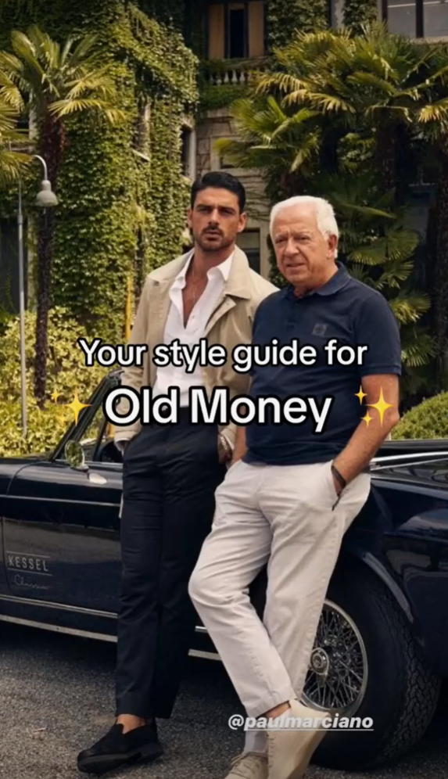
#OLDMONEY
1.7 billion TikTok shares
28 | Tatum

Slide 29
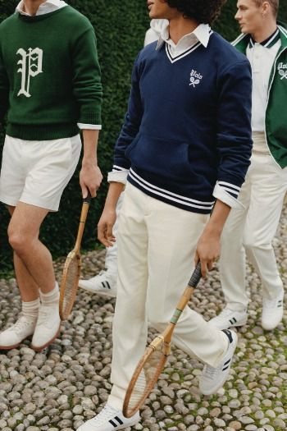
POTENTIAL RISKS
Tennis line cannibalization: sales eat into our tennis line
Brand Image: Pickleball has yet to achieve the same prestige of other sports
Competition: Tommy Hilfiger, Calvin Klein, Todd Snyder, Burberry

Slide 30
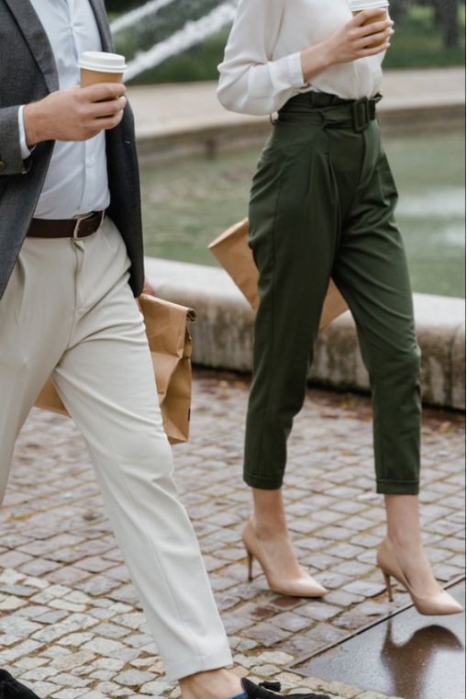
PAVING THE WAY
Community Events - Q2 FY 25-26
Creating a Tournament - Q4 FY 25-26
Official Trophy sponsor -Q1 FY 26-27

Slide 31
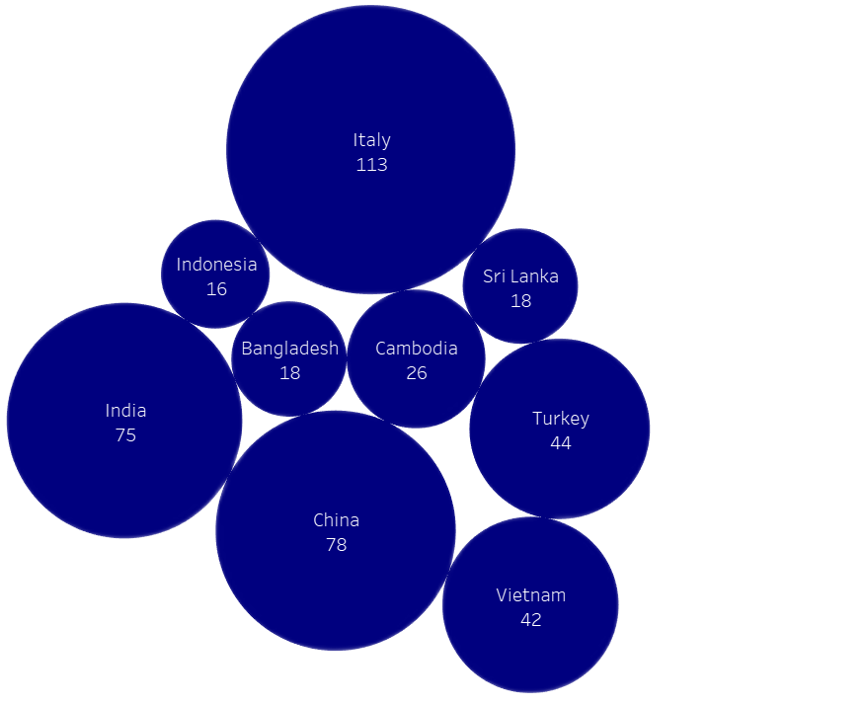
MANUFACTURING LOCATIONS

Slide 32
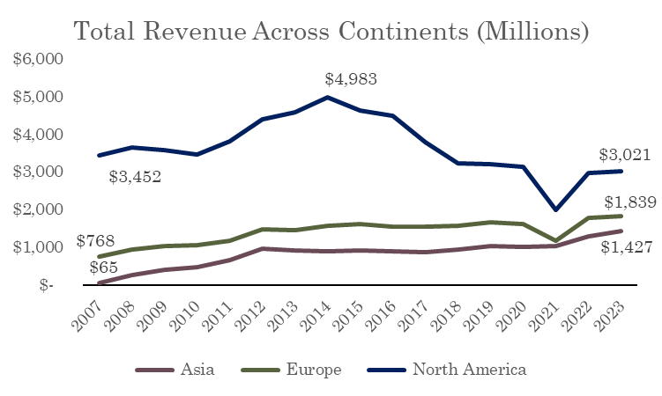
FINANCIAL OVERVIEW

